Slide 1
PREDICTING AFFLUENCE USING YELP PRICEPOINTS Colleen Kenney, Jerel Novick, Taylor Simpson

Slide 2
PROBLEM STATEMENT:
Can we use yelp price points ($, $$, $$$, $$$$) to predict affluence of a given area?

Slide 3
Approach
Data
Collection
EDA
Modeling

Slide 4
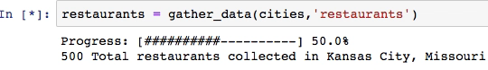
Data Collection
Understand the Yelp API & Gathering Business Data
Choose our locations
Most populous city in each states
Define function to retrieve data for a specific category
Restaurants, Nightlife, Hotels, Shopping, & Beauty

Slide 5
Data Collection
Define Affluence & Collect Data for Supervised Learning
Many measures of affluence
Chose Median Household Income
Define function to retrieve data for each city
Used http://www.city-data.com/city/

Slide 6
Data Collection
Aggregate Data and Merge w/ Affluence
Create a function to combine number of businesses per price point
$, $$, $$$, $$$$
85,000 businesses -> 50 observations
Merge w/ affluence metric

Slide 7
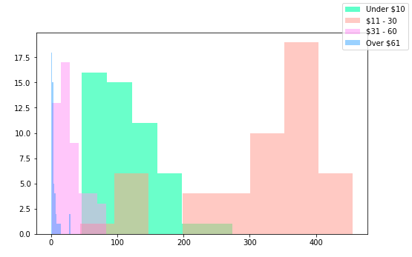
Exploratory Data Analysis
Understanding Distributions of Price Points
$$ are by far the most popular
Restaurant Price Point Distributions

Slide 8
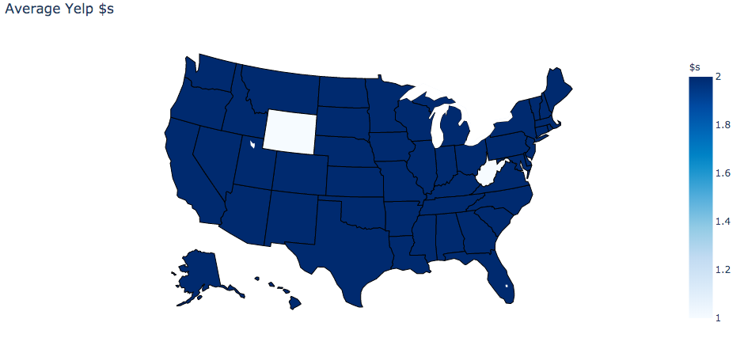
Exploratory Data Analysis
Understanding Distributions of Price Points
$$ are by far the most popular

Slide 9
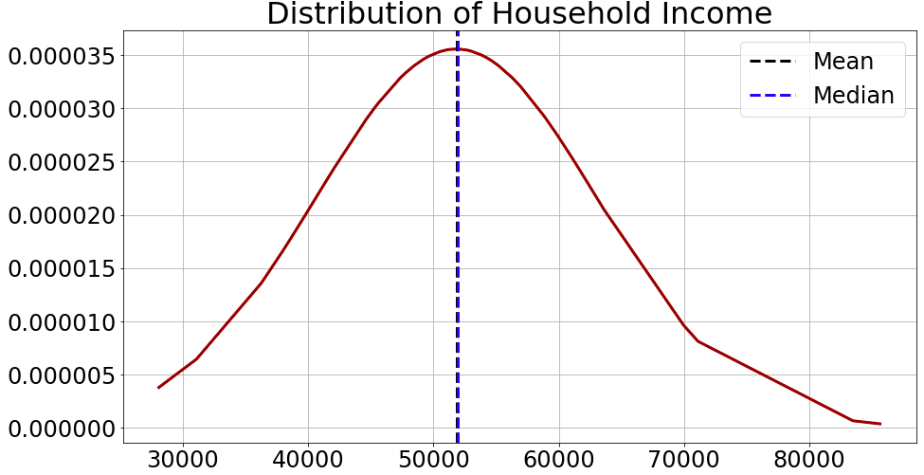
Exploratory Data Analysis
Understanding Distributions of Income
Looks fairly Normally Distributed

Slide 10
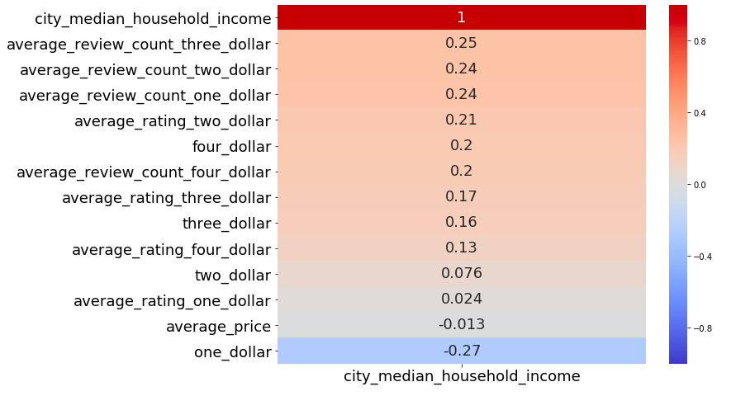
Exploratory Data Analysis
Visualizing Correlations
Not very correlated

Slide 11
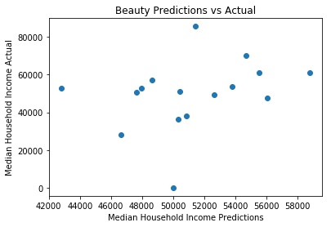
Initial Supervised Learning Model
Linear Regression
Fail to reject null hypothesis
coef | P>|t|
one_dollar | 0.389
two_dollar | 0.343
three_dollar | 0.312
four_dollar | 0.740

Slide 12
Additional Supervised Learning Model
Created Model on Different Features
Education
% High School or Higher
% Bachelors or Higher
Crime
Violent and Property Crimes per 100k
Home Values
Zillow Price Index
Population
Population
Land Area
Density

Slide 13
Additional Supervised Learning Model
Correlations
Not strongly correlated but better

Slide 14
Additional Supervised Learning Model
Linear Regression
Training Score: 0.8609 Test Score: 0.3832

Slide 15
Additional Supervised Learning Model
Linear Regression with Scaled Data
Training Score: 0.8609 Test Score: 0.0319

Slide 16
Additional Supervised Learning Model
Random Forest
Training Score: 0.9451 Test Score: -1.0817

Slide 17
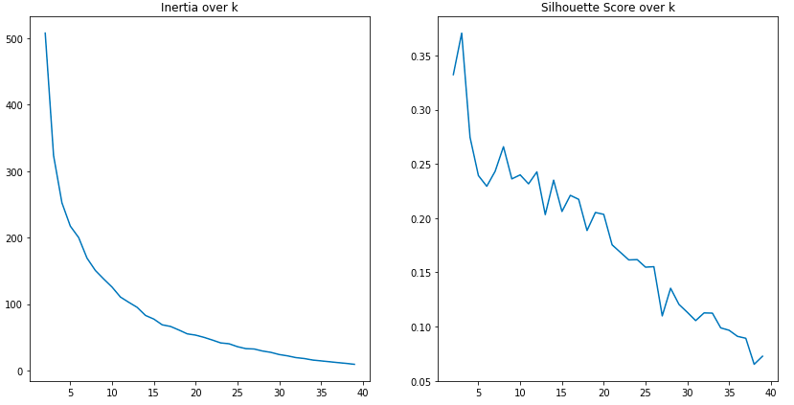
Clustering Model
Using Kmeans to identify Patterns
Inertia Over K Silhouette Score Over
500 -
0.35 -
0 40
0 40

Slide 18
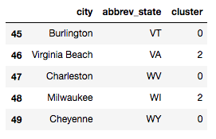
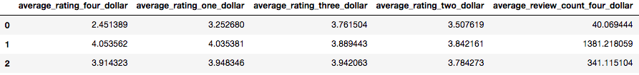
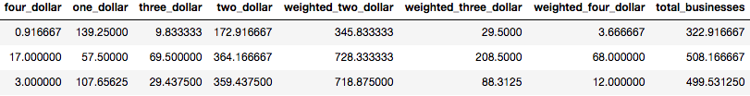
Clustering Model
Cluster Analysis for Restaurants
Example Cluster Assignments Centroid Means

Slide 19
Key Takeaways
Yelp API Limitations
Cannot reject null hypothesis
Other socioeconomic indicators are better, but more research is still needed
Clustering does separate cities with more businesses / more expensive restaurants

Slide 20
Next Steps
Gather More Data
Define other measures of affluence
Unemployment rate
Market Cap of Largest Employers
Gather more features
Longitude & Latitude
More Categories

Slide 21

THANKS!
Any questions?

